Slide 1

ONLINE MARKETING SERVICES

Slide 2
Table of Contents:
About Us
03
Current Marketing Plan
04
Recent Designs & Shoots
05
Proposed Strategy
06
Budget Breakdown
08
Questions? Get in Touch!
09

Slide 3
1
Best Company
Presence in 500+cities pan India.
About Us
2
3
Solutions designed to complete the entire purchase funnel Connecting all dots of the AIDA model Impacting Consumption Curating Conversion
Best Marketplace
Great Service
Consumption mindset hence more receptive to brand communication
Sharper customer segmentation basis consumption, affluence, lifestage, purchase readiness, passion, community and geography
4
5
Growing Company
Good Managemnet
SAB Marcom is a company that advances and continues to develop according to customer needs
SAB Marcom management is experienced and accomplished management

Slide 4
First Value
01
Prioritizing client needs to deliver tailored, impactful marketing solutions that drive success.
Second Value
02
Embracing new technologies and creative strategies to stay at the forefront of the marketing industry.
Company
Values
Third Value
03
Building trust through transparent, ethical practices and long-term client relationships.
Fourth Value
04
Fostering a team environment that values diverse perspectives to create holistic solutions.
Fifth Value
05
Committing to measurable outcomes that enhance both brand visibility and sales metrics.

Slide 5
Meta Ads
Influencer Marketing
Social Media
Current Marketing Plan

Slide 6
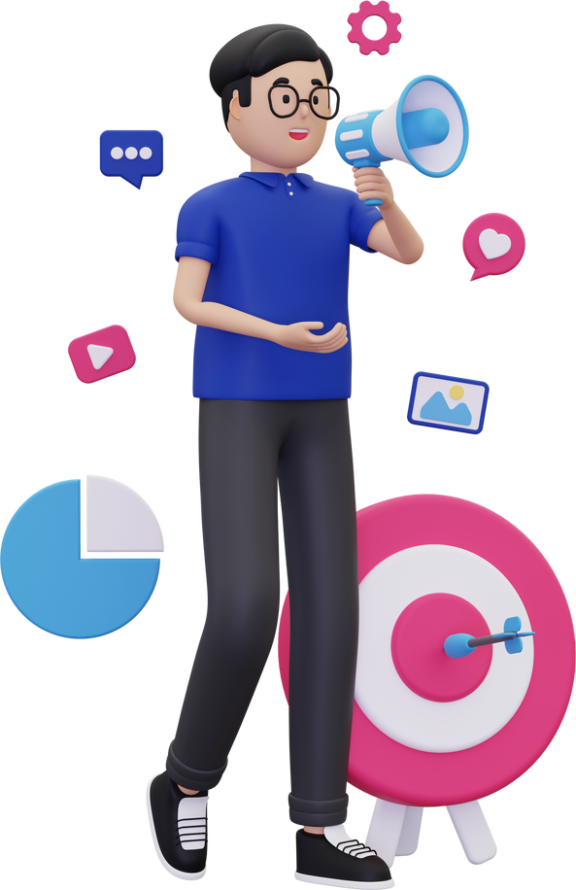
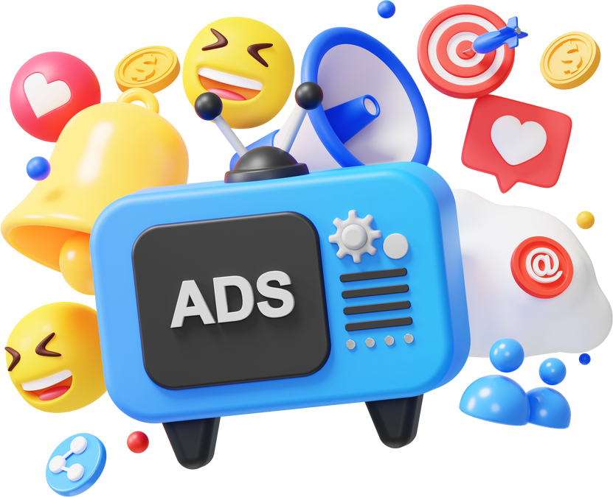
Meta Ads
Meta Ads are online advertisements that appear on Meta platforms like Facebook, Instagram, and Messenger. They allow businesses to target specific audiences based on demographics, interests, behaviors, and other factors. Meta Ads offer various formats, including images, videos, carousels, and stories, and can be used for a range of objectives such as increasing brand awareness, driving website traffic, generating leads, and boosting sales.

Slide 7
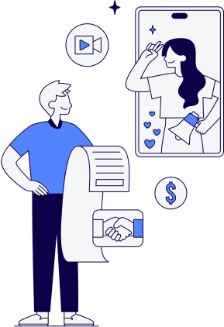
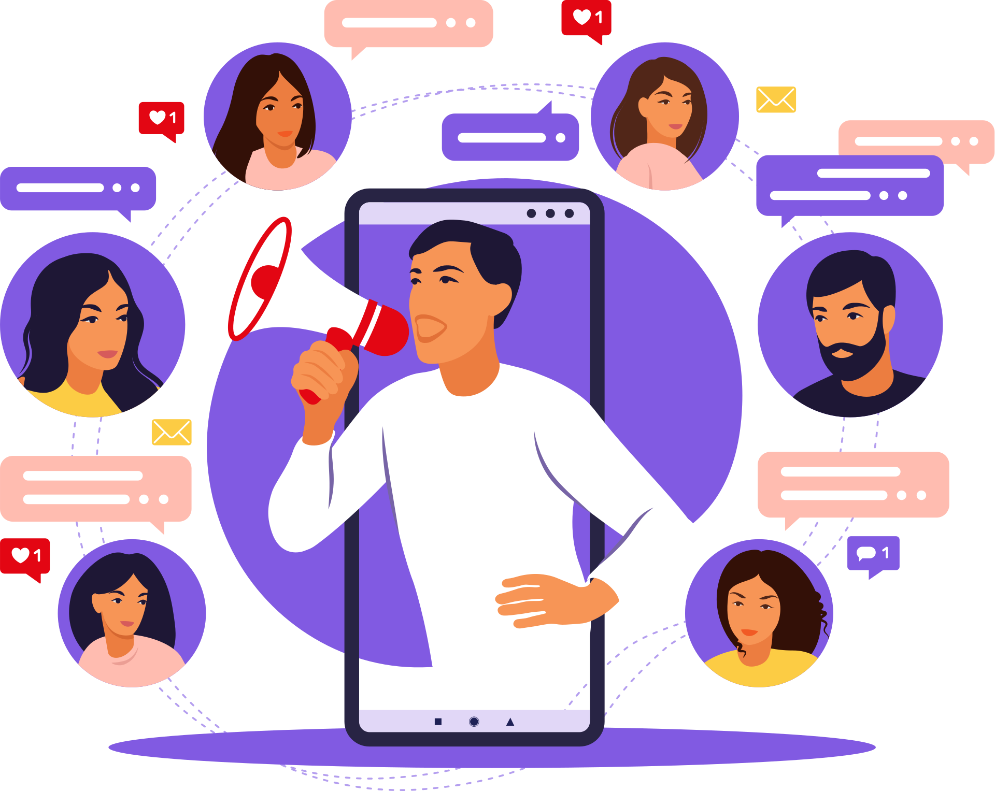
Influencer Marketing
Influencer marketing is a form of marketing that involves partnering with influential individuals or entities to promote a brand, product, or service. These influencers have a dedicated following and can use their credibility and reach to persuade their audience to take action, such as visiting stores and getting direct customer base. Influencer marketing can be a highly effective way to connect with a target audience and build brand awareness

Slide 8

Social Media
Social media content refers to the text, images, videos, and other materials that are shared on social media platforms. It can be used to engage with audiences, build brand awareness, drive traffic to a website, and generate leads. Effective social media content is relevant, engaging, and visually appealing. It should also align with the overall marketing goals of a business.

Slide 9
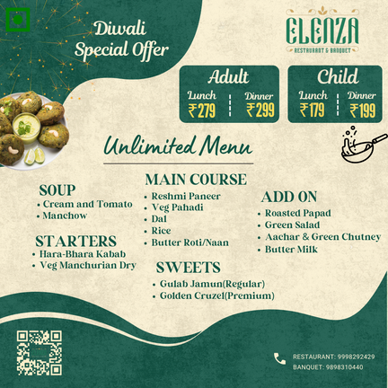

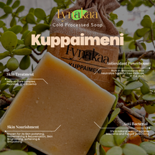
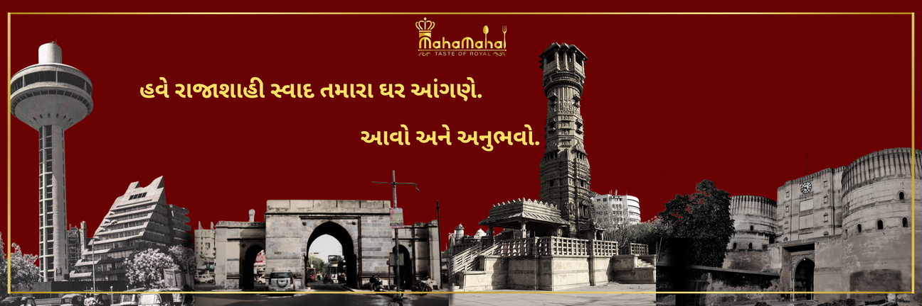
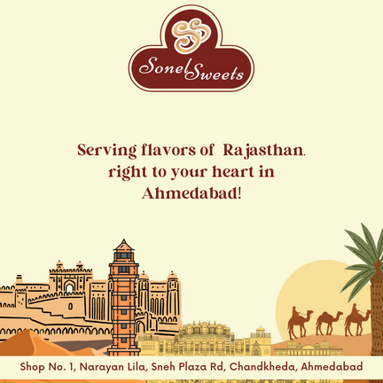

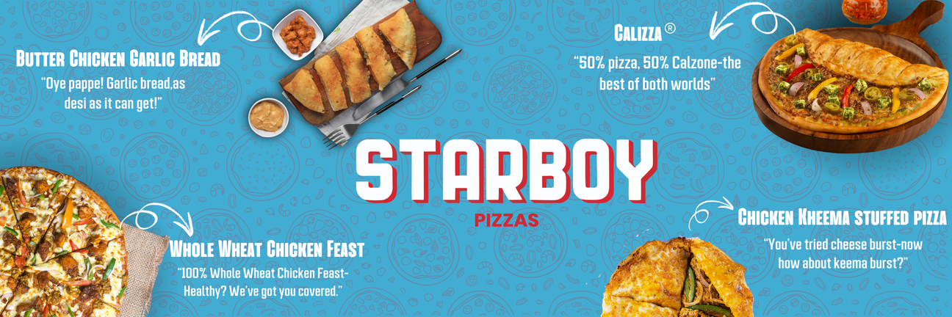
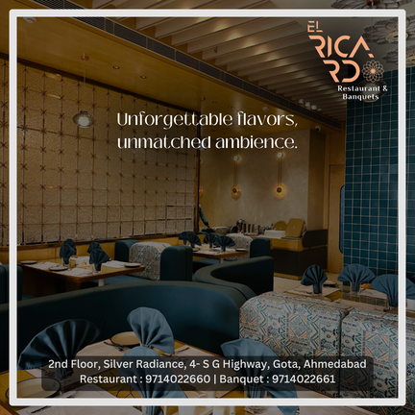
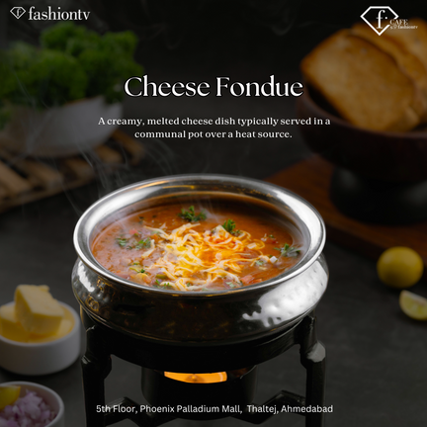
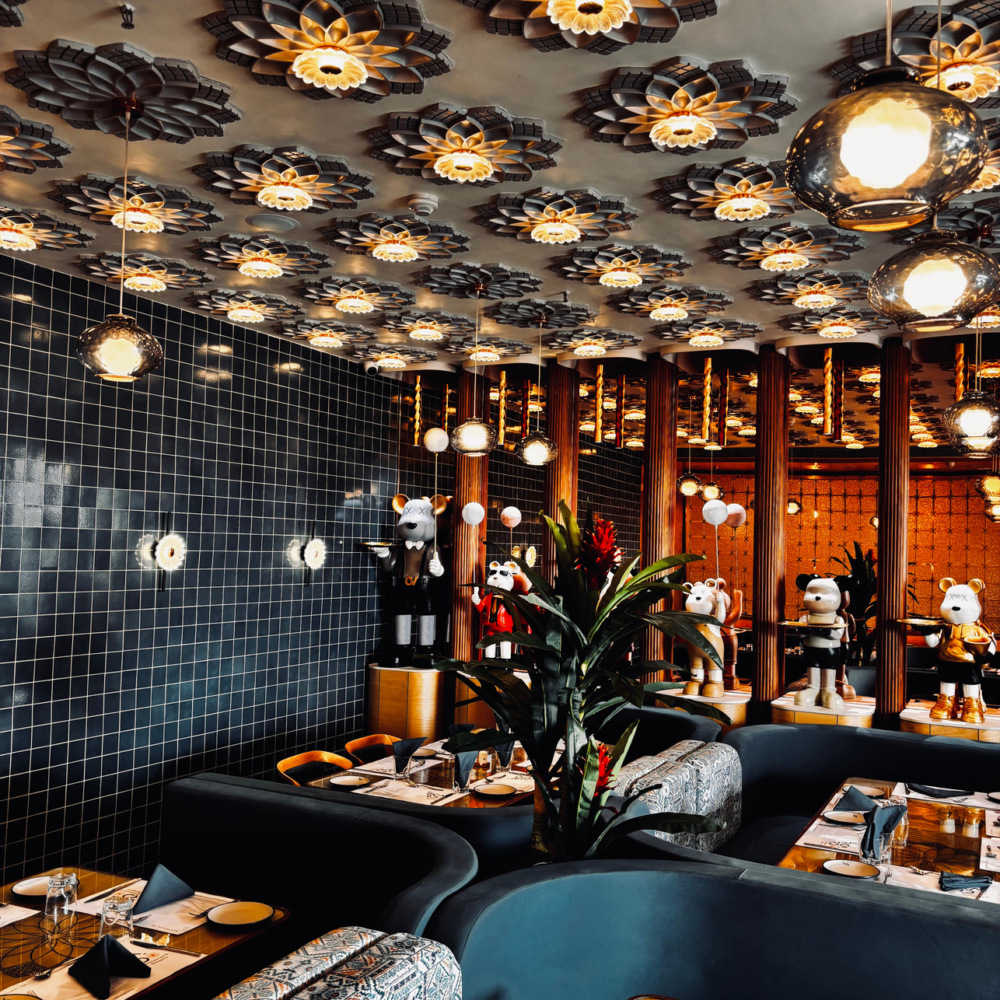
Recent Designs / Shoots

Slide 10
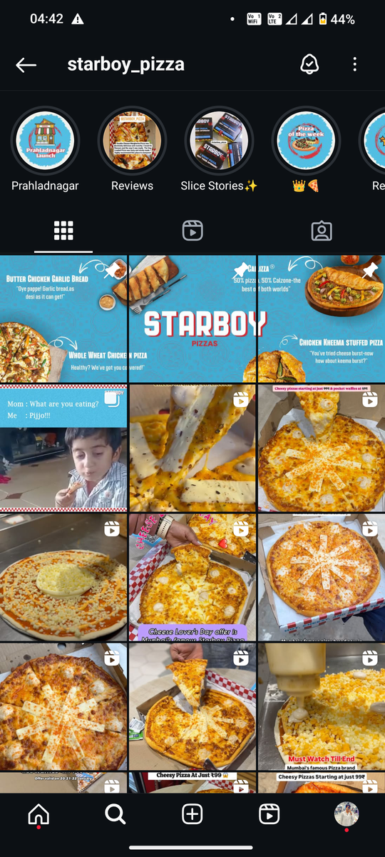
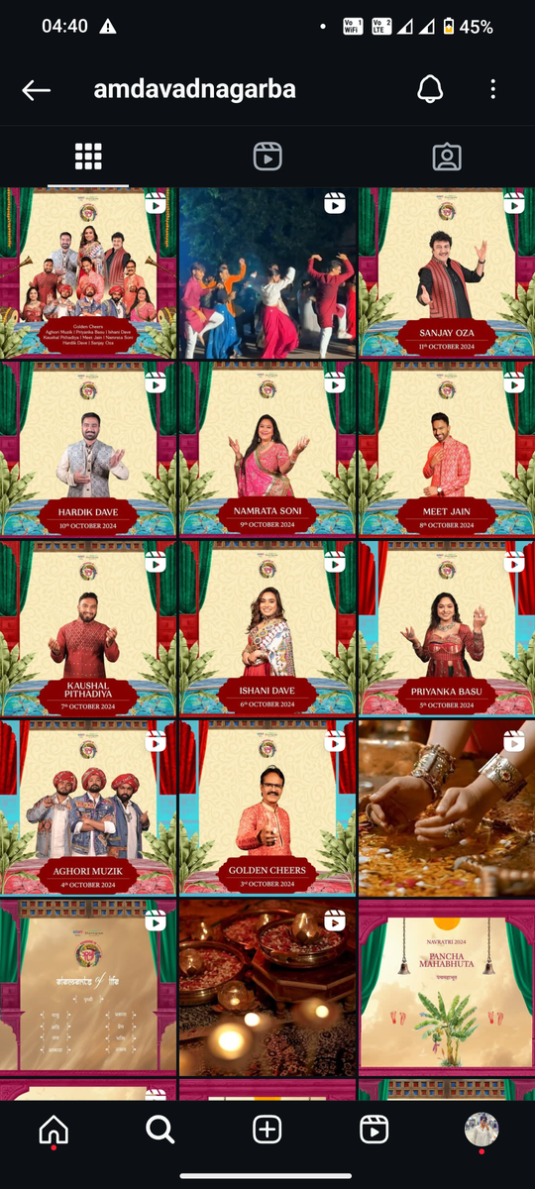
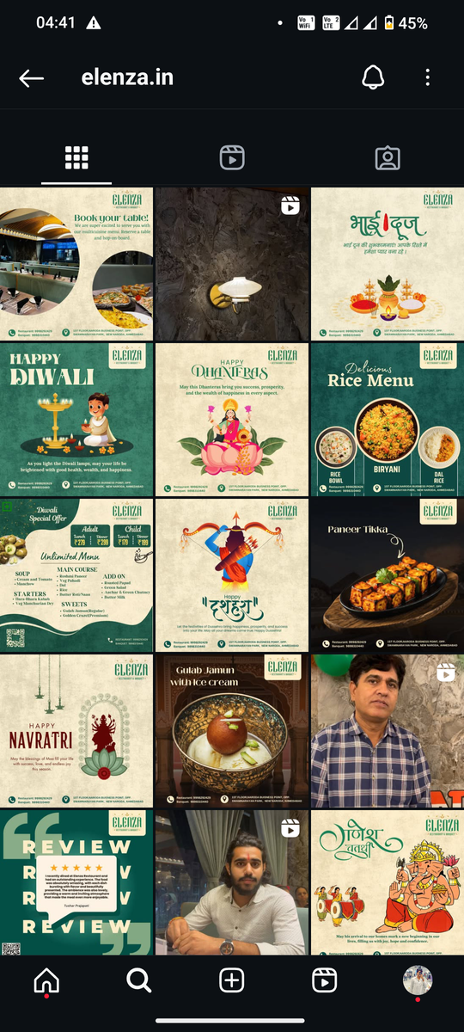
Previous Work Ex.
@starboy_pizza
@amdavadnagarba
@elenza.in

Slide 11
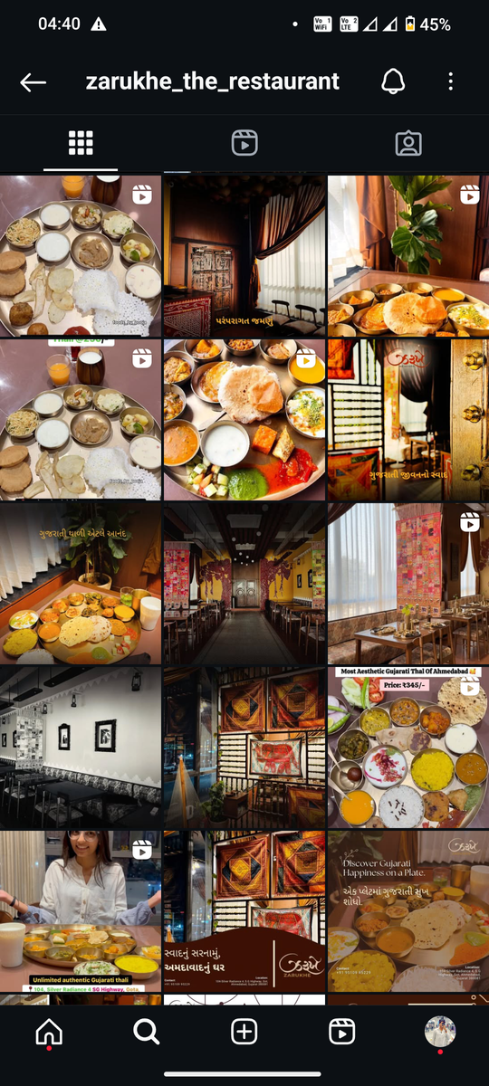
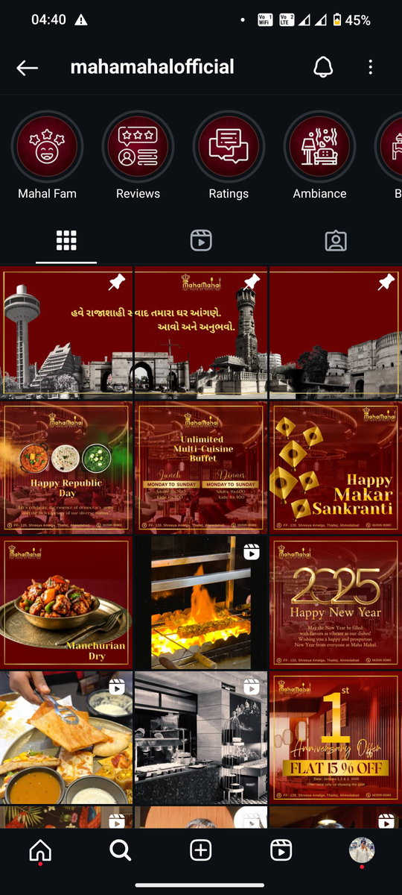
Previous Work Ex.
@zarukhe_the_restaurant
@mahamahalofficial

Slide 12
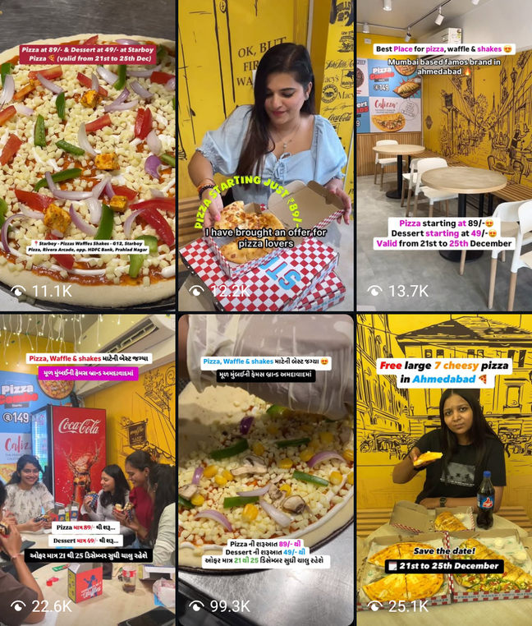
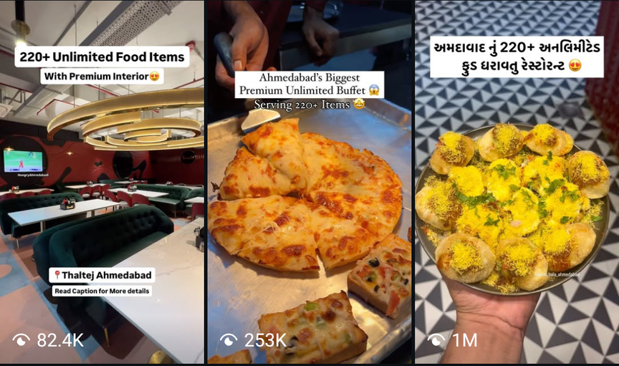

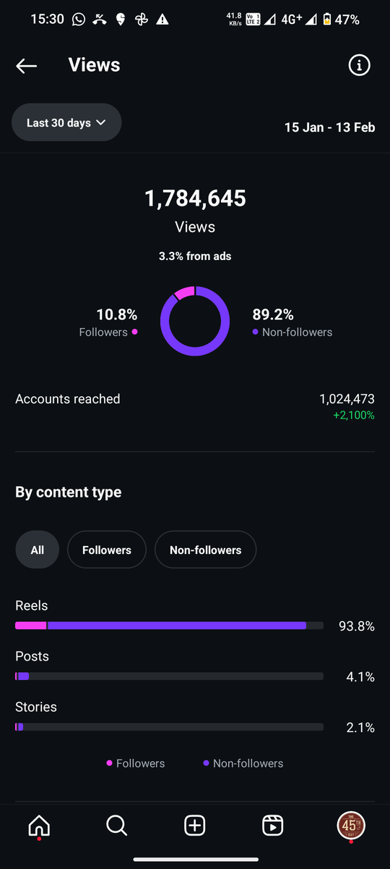

Influencers SOP and Reels
Better campaigns helpful with more reach and high engagement
Efficiency with posting time and strategy
Crafting large scale campaign for effective reach

Slide 13
Assets
Physical Asset
Digital Assistance
Digital Platform
Digital Asset
Consumer Data
Customer Experience

Slide 14


Thank You!
Dhiraj Chabbria
Director - Marketing
: dc@sabmarcom.com
+91 98700 79884

